Slide 1
J-1 Exchange Visitor
Preparing to Arrive

Slide 2
Agenda
Overview
Fermilab’s J-1 Program Rules
Your obligations and responsibilities as a participant in our Program
Tips for while you are here
Departing Fermilab
Local Resources

Slide 3
Overview

Slide 4
Overview
As a J-1 visa holder, you are participating in one of three 3 J-1 programs administered by Fermi Research Alliance (FRA) or the Universities Research Association at Fermilab.
Fermilab is permitted by the U.S. Department of State (“DOS”) to sponsor these J-1 programs at Fermilab.
The Visa Office is responsible for ensuring that both FRA and our “Exchange Visitors” comply with DOS regulations.
Our J-1 programs are audited each year by the DOS for compliance with their rules, regulations and recommendations.
If our J-1 programs are not in compliance with DOS rules, there is a risk that the DOS might limit or suspend our authorization to administer these programs.
The Visa Office also requires certain tasks or information from J-1 Exchange Visitors so that we can ensure that you maintain your status.

Slide 5
Overview
This presentation outlines the tasks and responsibilities placed on Exchange Visitors participating in our J-1 programs (Program Rules).
This Orientation also outlines the tasks and responsibilities of the Visa Office.
We will do our very best to process all paperwork and provide appropriate guidance, so that your visit to the U.S. is timely, productive, and as uncomplicated as possible.
As background, this Orientation is directed to YOU (the EVP Participant). WE are the Visa Office.

Slide 6
Overview - SEVIS
As a J-1 program participant, there is a record for you and for each accompanying family member, in a DOS database called SEVIS.
The Student and Exchange Visitor Information System (“SEVIS”) is an Internet-based system that maintains information on certain visitors to the U.S. (F, M, and J visa status holders).
SEVIS is accessed by the DOS and its Consulates, the U.S. Department of Homeland Security and CBP, other government agencies, and J-1 program sponsors.
The Visa Office is required to ensure that all information in SEVIS about you and your family members is accurate and up-to-date.

Slide 7
Program Rules
Your obligations and responsibilities as a participant in our Program

Slide 8
Program Rules
You must promptly advise of any change in your local address:
U.S. federal regulations require all J-1 exchange visitors to report a change of address within 10 days of moving.
If you move, please immediately report the change of address to:
The Visa Office (visaoffice@fnal.gov),
The U.S. Citizenship and Immigration Service using a Form AR-11 (www.uscis.gov/ar11), and
Either the Records Office (records@fnal.gov) if you are an employee, or the Users Office (usersoffice@fnal.gov) if you are a user.

Slide 9
Program Rules
You must promptly advise the Visa Office of any travel outside the U.S.
We must update your SEVIS record of any travel outside the U.S.
The signature of the Visa Office on the DS-2019 must be no more than 6 months old at the time you seek to re-enter the U.S.
If the visa stamp in your passport is expired, or will expire while you are traveling outside the U.S., tell the Visa Office as soon as you begin making your travel plans.
Each time you re-enter the U.S., scan and upload a copy of your new I-94 card to the online immigration system (ww2.welcomeclient.com).

Slide 10
Program Rules
You must report any changes in your plans, funding or program to the Fermilab Visa Office (visaoffice@fnal.gov) immediately.
Examples of changes:
Changes in the activities you are doing at Fermilab,
Changes in your supervisor, or
Changes to your program dates (early departures or a need to extend the program).

Slide 11
Program Rules
If you are subject to the Return Residence Requirement (§ 212(e)), you must promptly advise the Visa Office if you plan to apply for a waiver of this requirement.
We are prohibited from extending your program once a waiver application has been approved by the DOS.
We may extend your program while the waiver application is pending.
Please see http://get-connected.fnal.gov/visa/visa-assistance/212e-2/ for more information.

Slide 12
Program Rules
You must not accept funding from any institution other than your “home” institution outside the U.S., or the institution named on your DS-2019 as your Program Sponsor, unless you have obtained Visa Office approval for the funding.
If another institution offers to reimburse your travel expenses, contact the Visa Office prior to your trip to authorize such travel reimbursement.
Contact visaoffice@fnal.gov for more information.

Slide 13
While you are here

Slide 14
Online Immigration System
As you know, the Visa Office uses an online immigration system, at ww2.welcomeclient.com
Retain your password and user name for the system. You may need to access it periodically during your program.
Update your information online if there are changes (such as your local address).
Scan and upload new documents as you receive them (such as new I-94s, if you travel outside the U.S. during your program).
This ensures that when the Visa Office looks at your record, we have the most current and accurate information available to us.

Slide 15
Online Immigration System
If we request new information or documents,
Be complete and accurate in all your responses in all questionnaires and communications.
Understand, and be prepared to provide, all requested documents and information.
Timely respond to all messages or emails from the Visa Office.

Slide 16
Documents and Information
Always sign the DS-2019 with BLUE ink.
Retain copies of all DS-2019s ever issued to you.
Keep your passport and I-94 safe. The I-94 and DS-2019 are your only documents that demonstrate that you are lawfully in the U.S.
If your immigration-related paperwork is stolen, destroyed or lost:
Promptly report this to the Visa Office.
If stolen or lost, you also must report this to the local police.

Slide 17
Departing Fermilab

Slide 18
Your Last Day at Fermilab
If you are an employee of Fermilab:
Schedule an Exit Interview with the Employment Office (Wilson Hall, 15th Floor) for your last day.
Check out at the Key & ID Office (WH Ground Floor), after attending your Exit Interview.
If you are a Visiting Scientist, email the Visa Office (visaoffice@fnal.gov) as to when your last day onsite will be.

Slide 19
Computing Privileges
Computing privileges (Kerberos accounts) for Exchange Visitors often end at the same time as the DS-2019 expires.
If it is necessary for the computing privileges to continue past the expiration of the DS-2019, you must request this through the Computing Division website at
https://fermi.service-now.com/nav_to.do?uri=%2Fhome.do%3F
If your computing privileges continue past the expiration of your DS-2019, we must receive either
Confirmation of your travel plans for departure from the U.S., or
Your Fermilab ID Badge (which permits you site access).
In the absence of either of these, we must manually terminate your computing privileges. This is required by DOE rules relating to site access.

Slide 20
Local Resources

Slide 21
U.S. Immigration / Visa Information
The Visa Office maintains detailed information about U.S. immigration issues, including J-1 visa status:
http://get-connected.fnal.gov/
We also have an online appointment scheduler, for your convenience. Please email visaoffice@fnal.gov and the auto-responder includes a link to our online scheduler.

Slide 22
Sources of Information about Life in the U.S.
International Services holds a “Welcome to the USA” presentation once a month, or on demand.
The Orientation includes information about:
Drivers licenses
Banking
Social Security numbers
US Taxes
Local housing
US Health benefits,
And more…
Fermilab’s Employment Office maintains on online “International Orientation” http://orientation.fnal.gov/international-orientation/

Slide 23
Fermilab Organizations
NALWO: Lab organization for accompanying Exchange Visitor family members at Fermilab
http://orgs.fnal.gov/nalwo/
Graduate Students and Postdocs Association
http://orgs.fnal.gov/fspa/
GSA Guide to Life (currently under revision):
http://orgs.fnal.gov/fspa/pages/guide_to_life/index.html
Users Executive Committee
http://orgs.fnal.gov/fermilab_users_org/

Slide 24
Useful Fermilab Resources
Getting to Fermilab: http://www.fnal.gov/pub/visiting/hours/index.html
A map of the Fermilab site: http://www.fnal.gov/pub/visiting/map/site.html
Fermilab’s Accommodations Office:
http://fess.fnal.gov/accommodations/general_information.html
Fermilab’s Recreation Office
Main page: http://orgs.fnal.gov/fspa/old_site/guide/v2006/guide/node25.html
Clubs and organizations onsite: http://orgs.fnal.gov/fspa/old_site/guide/v2006/guide/node31.html
Fermilab’s Arts & Lecture Series
http://events.fnal.gov/
Fermilab’s Children’s Center (daycare, daycamp and other services)
http://hr.fnal.gov/work-life/family-balance/
Fermilab’s Diversity / Equal Employment Opportunity Office:
http://diversity.fnal.gov/
Fermilab’s Library: http://get-connected.fnal.gov/users/local-resources/ and http://get-connected.fnal.gov/usefulinformation/

Slide 25
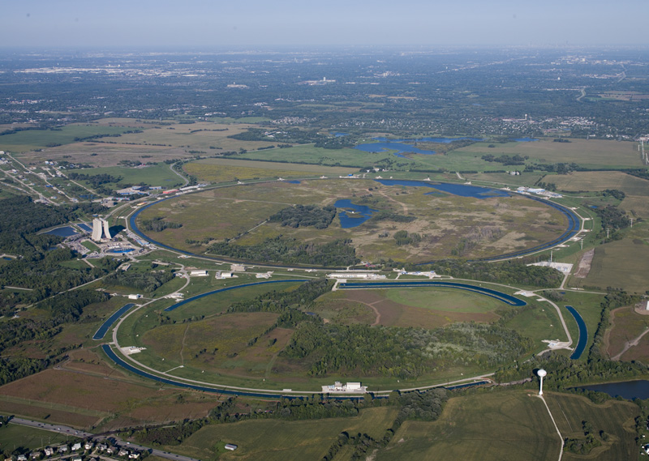
The Area around Fermilab
Fermi National Accelerator Laboratory (Fermilab), is located in Batavia, near Chicago, Illinois.
Batavia was founded in 1833.
It is split between Kane County and DuPage County in Illinois.
Its population was 23,866 at the time of the 2000 U.S. Census.
Batavia is part of a Tri-Cities area, along with St. Charles and Geneva.

Slide 26
Local Resources
Illinois Department of Tourism
http://www.enjoyillinois.com/home.aspx
DuPage County
Main page: http://www.dupageco.org/
Bikeways and Trails: http://www.co.dupage.il.us/bikeways/index.cfm
Visitor’s Bureau: http://www.discoverdupage.com/
Kane County
http://www.countyofkane.org/Pages/default.aspx
Chicago
Chicago Tourism: http://www.explorechicago.org/city/en.html
Chicago transportation: http://rtachicago.com/
Pace Transportation: http://www.pacebus.com/sub/schedules/default.asp
Local transportation for Batavia and the surrounding areas.
Metra Train System: http://metrarail.com/metra/en/home.html

Slide 27
Local Resources
Local newspapers
http://www.countyofkane.org/Pages/LocalNewspapers.aspx
DuPage County Health Department:
http://www.dupagehealth.org/
Kane County Health Department (with links to local hospitals and other resources)
http://www.kanehealth.com/links.htm
The Users Office maintains a listserv for “newcomers” to Fermilab.
Contact usersoffice@fnal.gov to be subscribed to this list.

Slide 28
We look forward to your Arrival
Please keep us apprised of your plans (email visaoffice@fnal.gov):
When you book your visa appointment, and the date it is scheduled to take place,
When you receive your visa stamp and passport,
If there are delays in either scheduling your visa appointment or in the Consulate’s issuance of your visa, and
The date you expect to arrive at Fermilab.
If you will be employed by Fermilab:
Please coordinate your travel plans with your recruiter and the Employment Office.

Slide 29
Questions?
Email Fermilab’s International Services/Visa Office at visaoffice@fnal.gov
Or call us directly:
Valery Stanley at 630-840-3933
Kappatolia Sherman at 630-840-3811
For clarification of, guidance regarding, and improvements to the Exchange Visitor Program, please email the U.S. Department of State at jvisas@state.gov, or consult their website at: http://travel.state.gov/.

